Slide 1
Loop

Slide 2
What is Loop?
A loop helps in executing one or more statements up to a desired number of times.
1
2
For Loop
While Loop
Iterates over a sequence such as a list or a tuple.
Executes a block of code repeatedly as long as a specified condition remains true.

Slide 3
For Loop

Slide 4
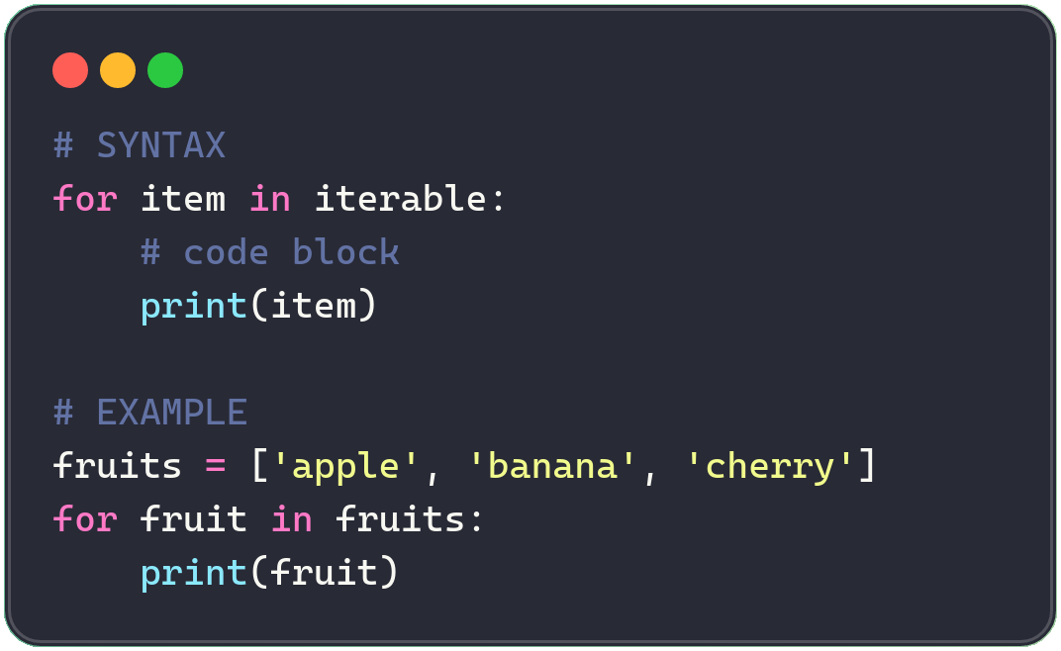
What is For Loop?
01 · CONCEPTS
Visualize the code
The 'for' loop is used to iterate over a collection data type (list, tuple, string) or other iterable objects.
Insight: the loop variable (fruits) takes on each value in the collection, one at a time.

Slide 5
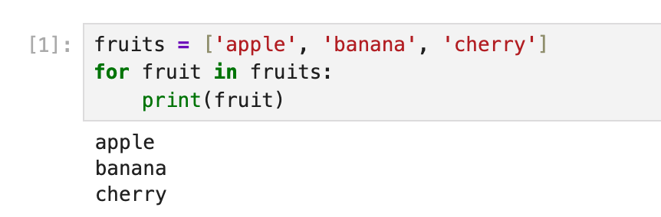
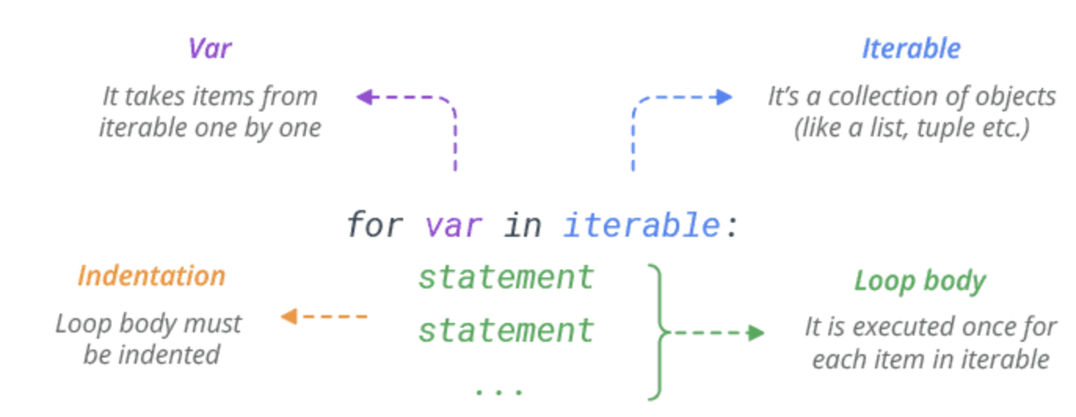
Code Example
For Loop
SYNTAX
Insight: the loop variable (var) takes on each value in the sequence, one at a time.
Code visualizer:
https://programiz.pro/code-visualizer/python
https://pythontutor.com/visualize.html#mode=display
https://learn-code-with-vengleab.vercel.app/
4
Notes:
fruits = ['apple', 'banana', 'cherry']
for fruit in fruits:
print(fruit)

Slide 6
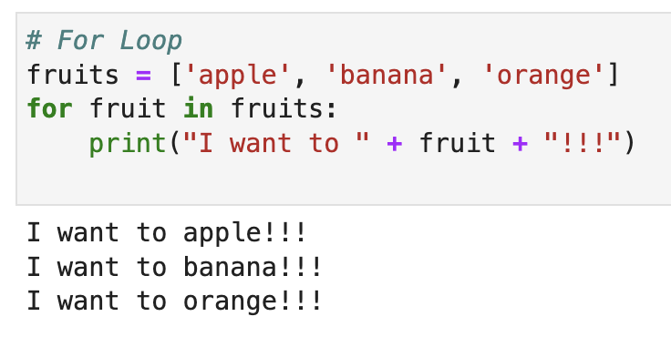
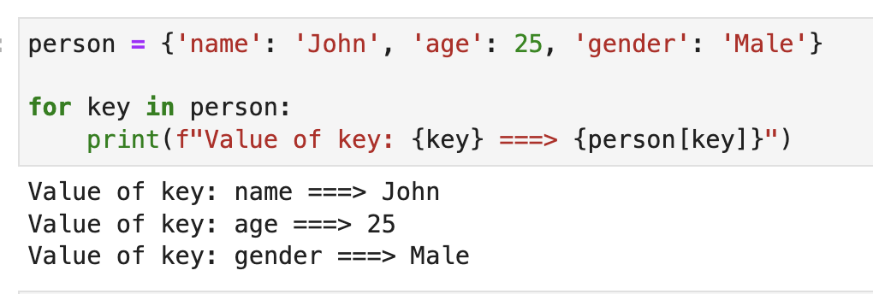
For Loop with List or Tuple
For loop with dictionary

Slide 7
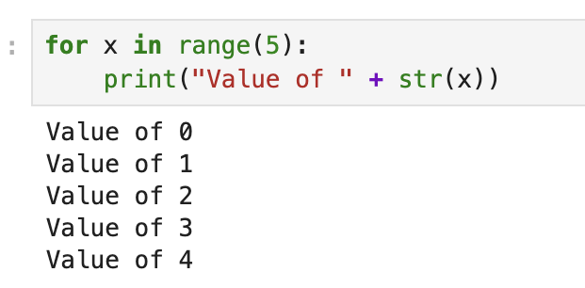
Using Range(n) with For Loop
range(n) is commonly used with for loop to generates a sequence of numbers starting from 0 up to n - 1
Note: Range change be multiple syntax
range(n)
range(start, stop)
range(start, stop, step)

Slide 8
While Loop

Slide 9
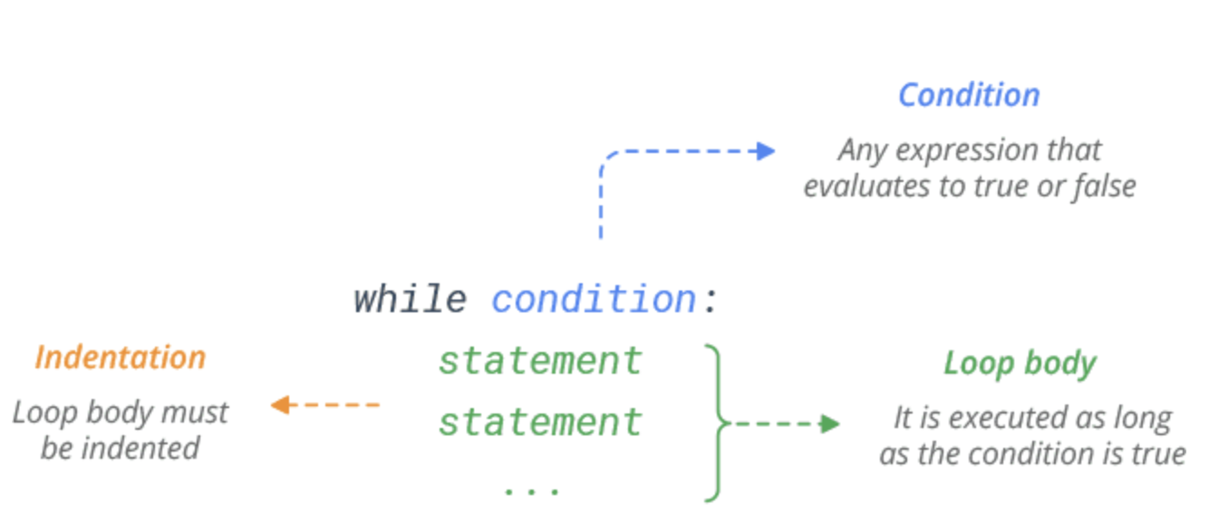
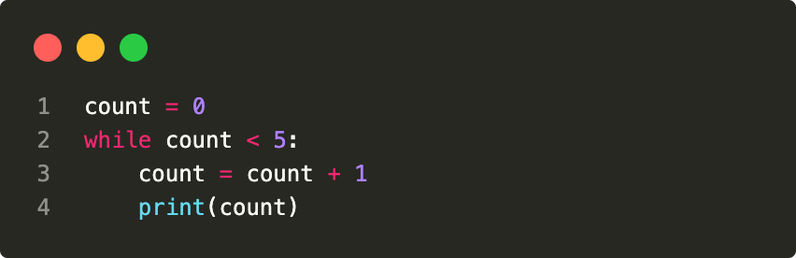
What is While Loop?
Syntax
01 · CONCEPTS
Executes a block of code repeatedly as long as a specified condition remains true.
EXECUTION FLOW
1
Evaluate condition
2
True → run body
3
Go back to step 1
Example
4
False → exit loop
Insight: always ensure your condition eventually becomes False, or use break — otherwise it runs forever!
Notes:
count = 0
while count < 5:
count = count + 1
print(count)

Slide 10
Visualize Code Execution

Slide 11
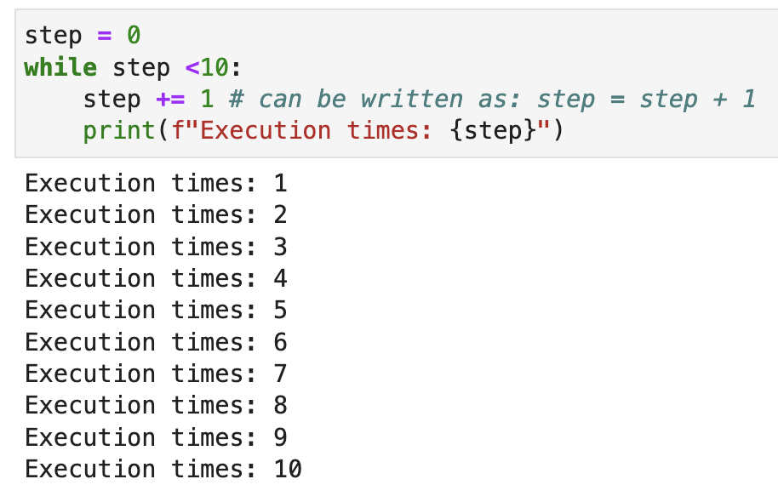
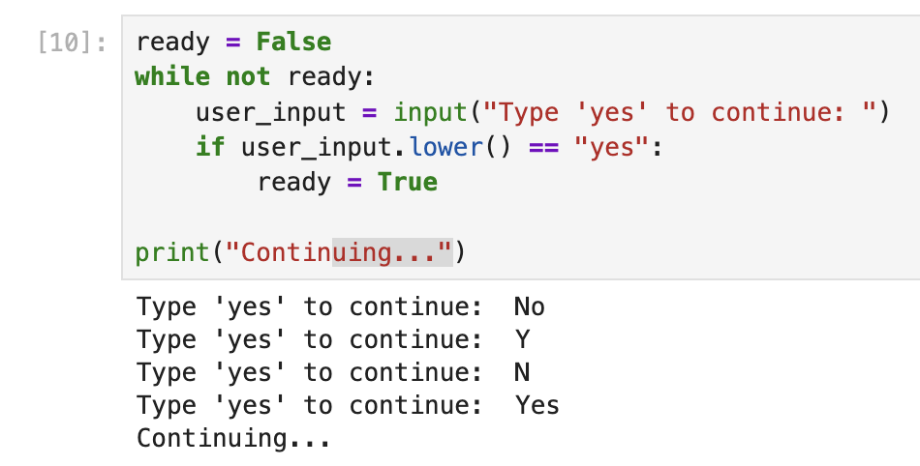
Run until correct
Run multiple times
Similar to range(10) with for loop

Slide 12
Transfer Statements

Slide 13
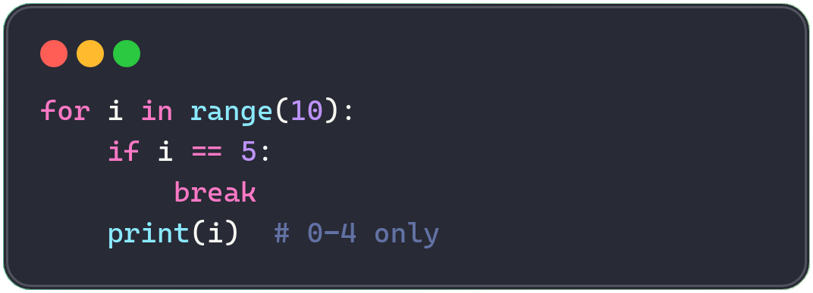
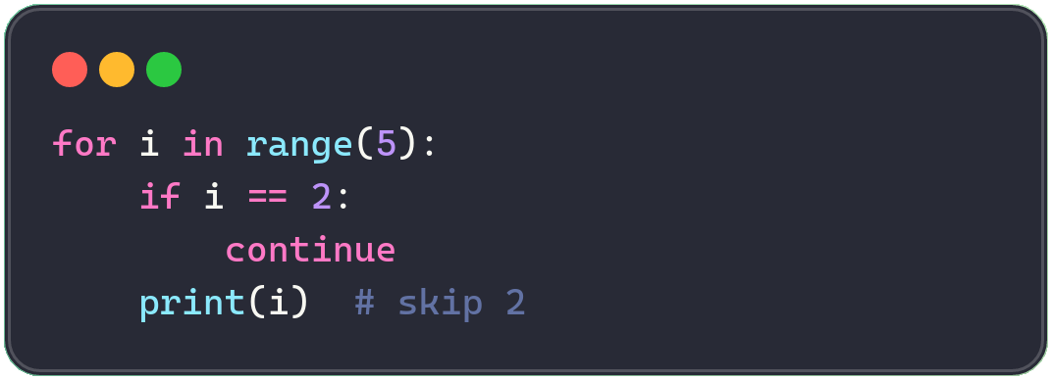
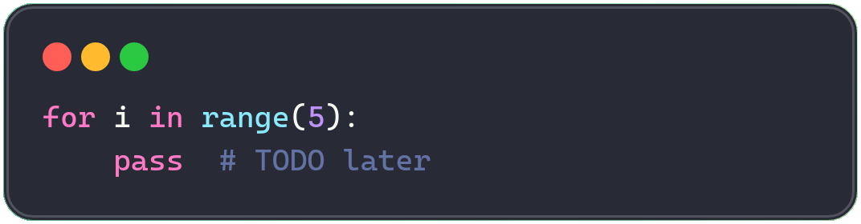
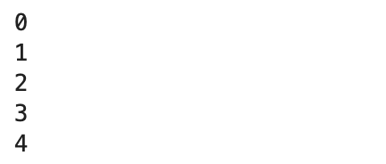
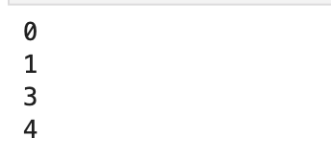

JUMP AROUND
Transfer Statements
Keywords that modify the normal top-to-bottom flow by jumping execution to a different point — think of them as traffic signs.
break
continue
pass
Exit the loop immediately.
Skip the current iteration.
Placeholder — do nothing.
11

Slide 14
More with Loop

Slide 15
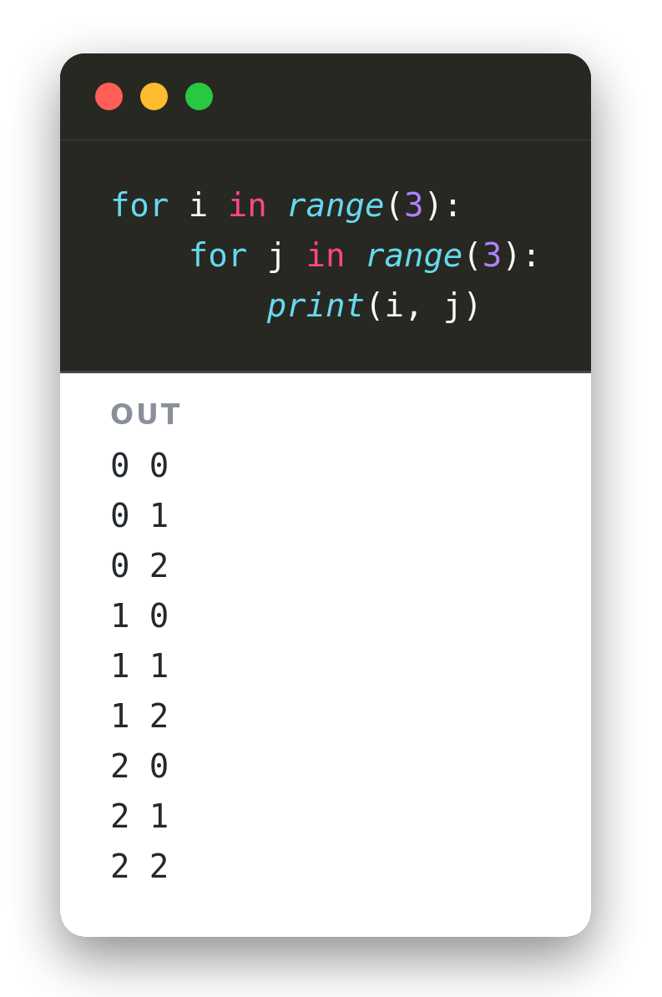
Nested Loops
A loop inside a loop
The inner loop runs to completion for every single pass of the outer loop.
Useful for grids, pairs, and coordinates — anywhere you need i and j together.
range(3) twice gives 9 total iterations — 3 outer × 3 inner.
Notes:
for i in range(3):
for j in range(3):
print(i, j)
# (0,0) (0,1) (0,2)
# (1,0) (1,1) (1,2) ...

Slide 16
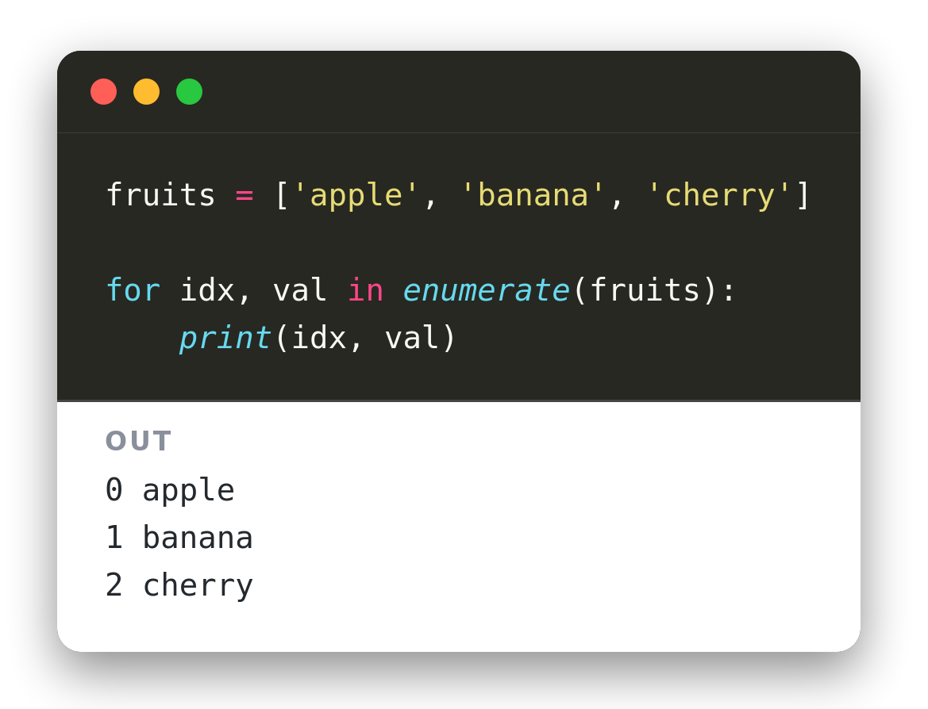
enumerate()
Index and value, together
enumerate() wraps a list and yields (index, value) pairs.
No need to track a counter by hand or call len().
Cleaner and more Pythonic than looping over range(len(list)).
● Insight: use enumerate() instead of range(len(list)) for cleaner, more Pythonic code.
Notes:
fruits = ['apple', 'banana', 'cherry']
for idx, val in enumerate(fruits):
print(idx, val) # 0 apple ...

Slide 17
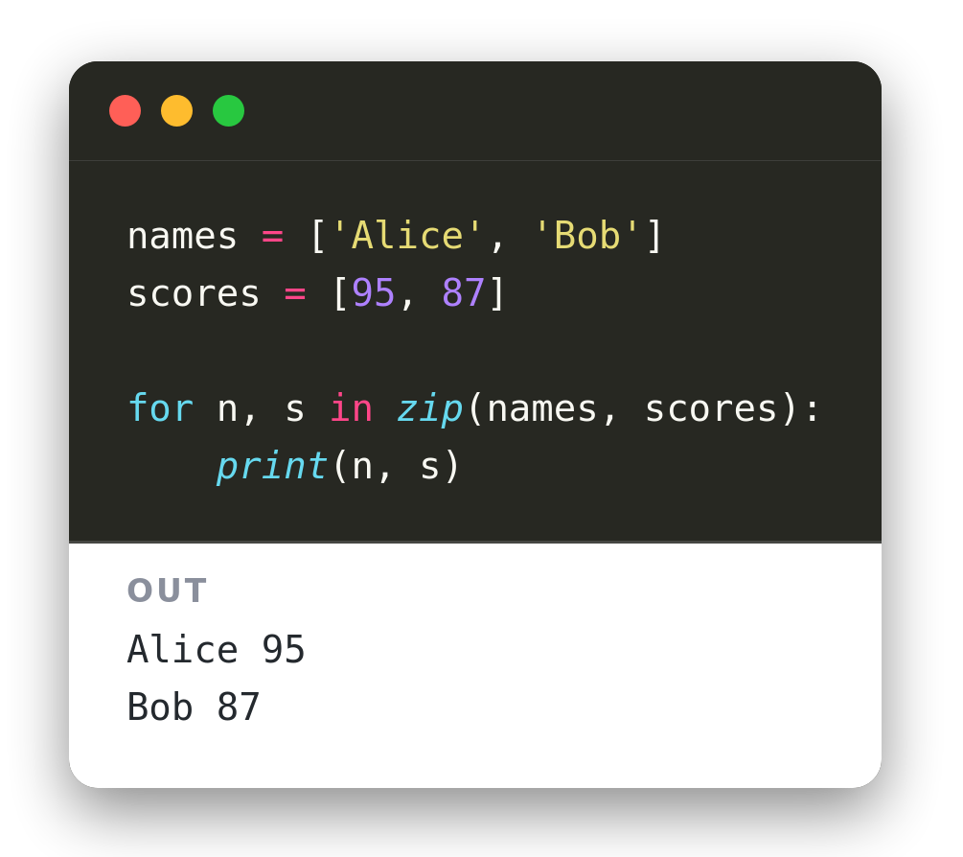
zip()
Pair up parallel lists
zip() walks two (or more) lists side by side.
Each step returns one item from each list, in the same order.
Stops automatically at the shortest list if lengths differ.
Notes:
names = ['Alice', 'Bob']
scores = [95, 87]
for n, s in zip(names, scores):
print(n, s)

Slide 18
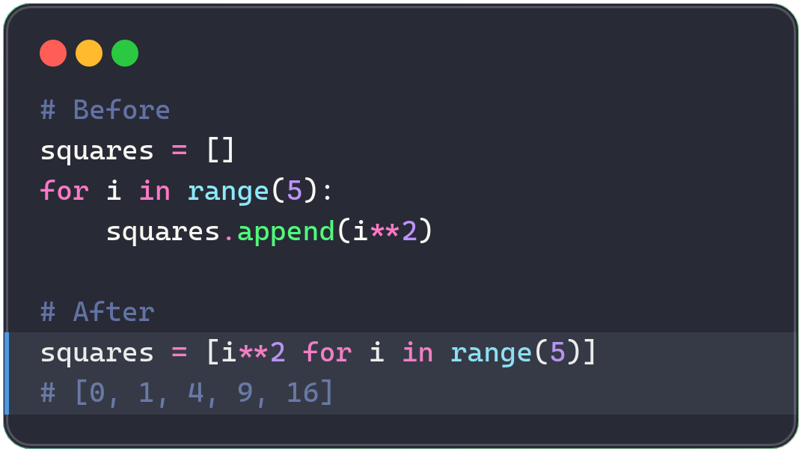
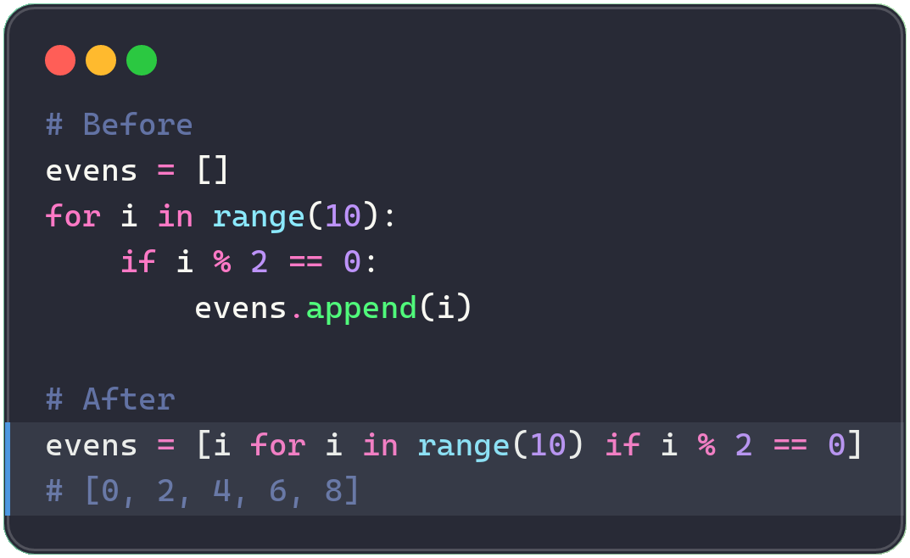
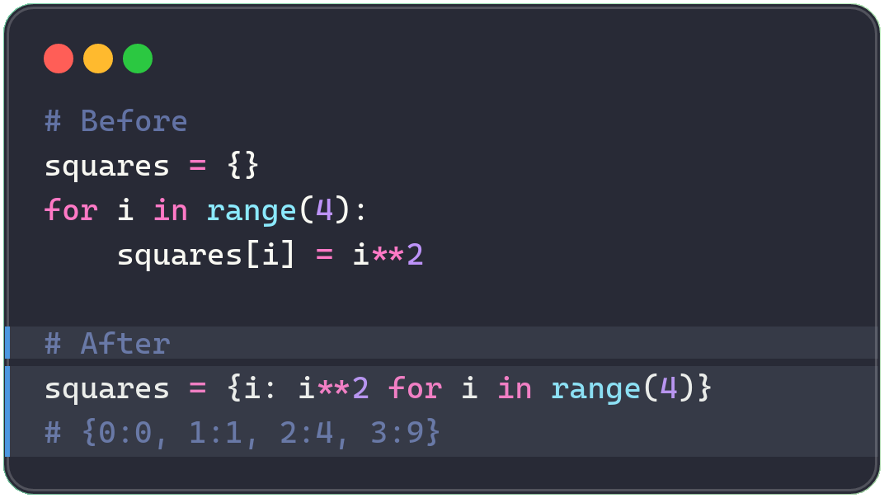
List Comprehensions
Syntax: [expression for item in iterable if condition]
Basic — Squares
With Filter — Evens
Dict Comprehension
13

Slide 19
Practices: Foundations

Slide 20
Part 1: Loop with For Loop

Slide 21
Part 1: Loop with For Loop
1
Count from 1 to 10
2
Print Even Numbers
Print the numbers from 1 to 10.
Hint: use range(1, 11)
Print every even number from 2 to 20 (inclusive).
Hint: use a step of 2 in range() or using %
Expected output:
Expected output:
1, 2, 3, 4, 5, 6, 7, 8, 9, 10
2, 4, 6, 8, 10, 12, 14, 16, 18, 20
3
Sum of Numbers
4
Loop Through a List
Calculate and print the sum of all numbers from 1 to 100.
Given the list: [‘apple’, ‘banana’, ‘cherry’]
print each fruit on its own line.
Expected output:
Expected output:
Sum: 5050
apple
banana
cherry
Notes:
# --- Problem 1: Count from 1 to 10 ---
for i in range(1, 11):
print(i, end=", " if i < 10 else "\n")
# --- Problem 2: Print Even Numbers ---
for i in range(2, 21, 2):
print(i, end=", " if i < 20 else "\n")
# --- Problem 3: Sum of Numbers ---
total = 0
for i in range(1, 101): # Note: range(1, 101) includes 100
total += i
print(f"Sum: {total}")
# --- Problem 4: Loop Through a List ---
fruits = ['apple', 'banana', 'cherry']
for fruit in fruits:
print(fruit)

Slide 22
Part 2: Loops with While

Slide 23
Part 2: Loops with While
5
Countdown
6
Multiplication Table
Countdown from 10 to 1.
Then print "Done!"
Print the 5 times table — from 5 x 1 up to 5 x 10.
Expected output:
Expected output:
10, 9, 8, 7, 6, 5, 4, 3, 2, 1
Done!
5 x 1 = 5
5 x 2 = 10
...
5 x 10 = 50
7
Count Vowels in a String
8
Find the Largest Number
Count how many vowels (a, e, i, o, u) appear in "programming".
Find the largest value in [14, 58, 2, 99, 43].
Hint: use a value to store larger number every step
Constraint: don't use max()
Expected output:
Expected output:
Vowel count: 3
Largest number: 99
Notes:
# --- Problem 5: Countdown ---
count = 10
while count >= 1:
print(count, end=", " if count > 1 else "\n")
count -= 1
print("Done!")
# --- Problem 6: Multiplication Table ---
num = 5
i = 1
while i <= 10:
print(f"{num} x {i} = {num * i}")
i += 1
# --- Problem 7: Count Vowels in a String ---
text = "programming"
vowels = "aeiou"
count = 0
i = 0
while i < len(text):
if text[i] in vowels:
count += 1
i += 1
print(f"Vowel count: {count}")
# --- Problem 8: Find the Largest Number ---
numbers = [14, 58, 2, 99, 43]
largest = numbers[0]
idx = 1
while idx < len(numbers):
if numbers[idx] > largest:
largest = numbers[idx]
idx += 1
print(f"Largest number: {largest}")

Slide 24
Practices: More with loop

Slide 25
Practices: More with loop
1
Transaction Categorization
2
High-Value Transaction Filter
Loop through the account amounts
if/else: positive -> Income, else -> Expense
Print each amount with its label
Loop through daily transaction values
if value > $1,000: add it to the total
Print the final flagged total
amounts = [150.0, -45.5, -12.0, 3000.0, -8.99]
# TODO: for each amount, print Income or Expense
for amt in amounts:
pass
values = [25, 499, 1200, 85, 5000, 310]
total = 0
# TODO: if value > 1000, add to total
for v in values:
pass
$150.00 -> Income
-$45.50 -> Expense
-$12.00 -> Expense
$3000.00 -> Income
-$8.99 -> Expense
Total high-value transactions: $6200
Notes:
# --- Problem 1: Transaction Categorization ---
amounts = [150.0, -45.5, -12.0, 3000.0, -8.99]
for amt in amounts:
category = "Income" if amt > 0 else "Expense"
sign = "" if amt >= 0 else "-"
print(f"{sign}${abs(amt):.2f} -> {category}")
# --- Problem 2: High-Value Transaction Filter ---
values = [25, 499, 1200, 85, 5000, 310]
total = 0
for v in values:
if v > 1000:
total += v
print(f"Total high-value transactions: ${total}")

Slide 26
Practices: More with loop
3
Credit Score Classifier
4
Skip Zero-Fee Accounts
if score >= 700 -> Prime
elif 620-699 -> Near-Prime
else -> Subprime
if fee == 0.0: continue to skip it
Print only the active fee charges
Practice the continue keyword
scores = [720, 580, 810, 640, 520]
# TODO: if/elif/else classify each score
for score in scores:
pass
fees = [12.0, 0.0, 15.0, 0.0, 8.5]
# TODO: continue past any $0.0 fee
for fee in fees:
pass
720 -> Prime
580 -> Subprime
810 -> Prime
640 -> Near-Prime
520 -> Subprime
Fee: $12.00
Fee: $15.00
Fee: $8.50
Notes:
# --- Problem 3: Credit Score Classifier ---
scores = [720, 580, 810, 640, 520]
for score in scores:
if score >= 700:
category = "Prime"
elif score >= 620:
category = "Near-Prime"
else:
category = "Subprime"
print(f"{score} -> {category}")
# --- Problem 4: Skip Zero-Fee Accounts ---
fees = [12.0, 0.0, 15.0, 0.0, 8.5]
for fee in fees:
if fee == 0.0:
continue
print(f"Fee: ${fee:.2f}")

Slide 27
Practices: More with loop
5
Your task
Print each trade price as you go
if price < $90: print Trading Halted
break immediately — stop processing
prices = [100, 102, 101, 88, 82, 79]
# TODO: if price < 90, print + break
for price in prices:
pass
Expected output:
100
102
101
Trading Halted
Notes:
# --- Problem 5: Trading Halt ---
prices = [100, 102, 101, 88, 82, 79]
for price in prices:
if price < 90:
print("Trading Halted")
break
print(price)

